Slide 1

Game Project: PyAdventures
Designed & Developed
By
Lyubomira Dimitrova

Slide 2

Introduction
What is PyAdventures?
A game-based learning tool designed to teach Python programming.
Target Audience:
Beginners, young adults, and first-year university students.
Why It Matters:
Traditional programming education can be challenging and unengaging. PyAdventures makes it fun!

Slide 3
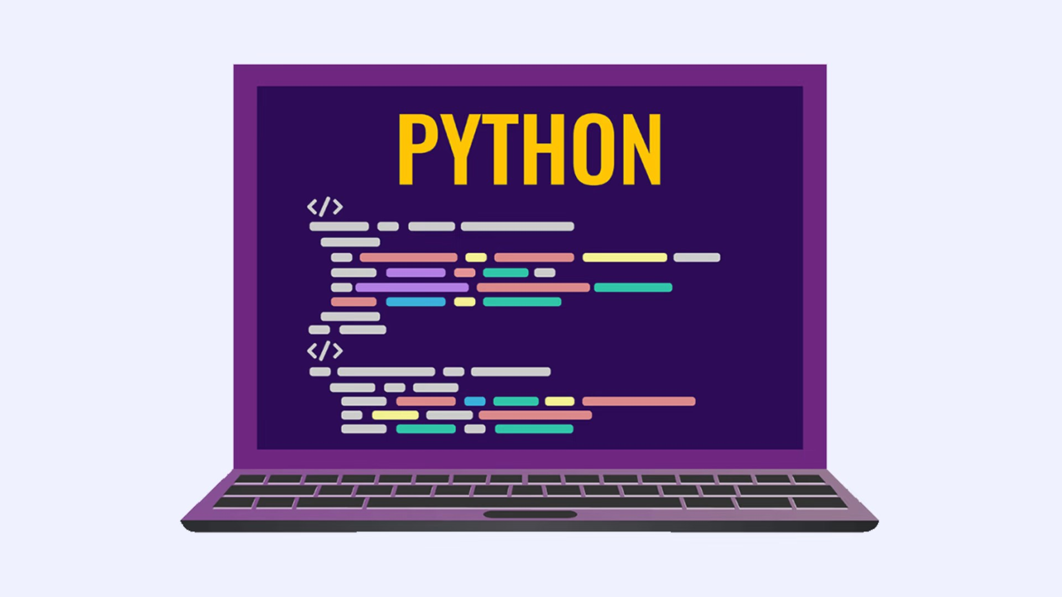
The Challenge of Programming Education
Common Issues with Traditional Methods:
Difficult concepts and syntax can overwhelm beginners.
Lack of motivation due to dry, theoretical learning.
Limited hands-on practice and immediate feedback.

Slide 4
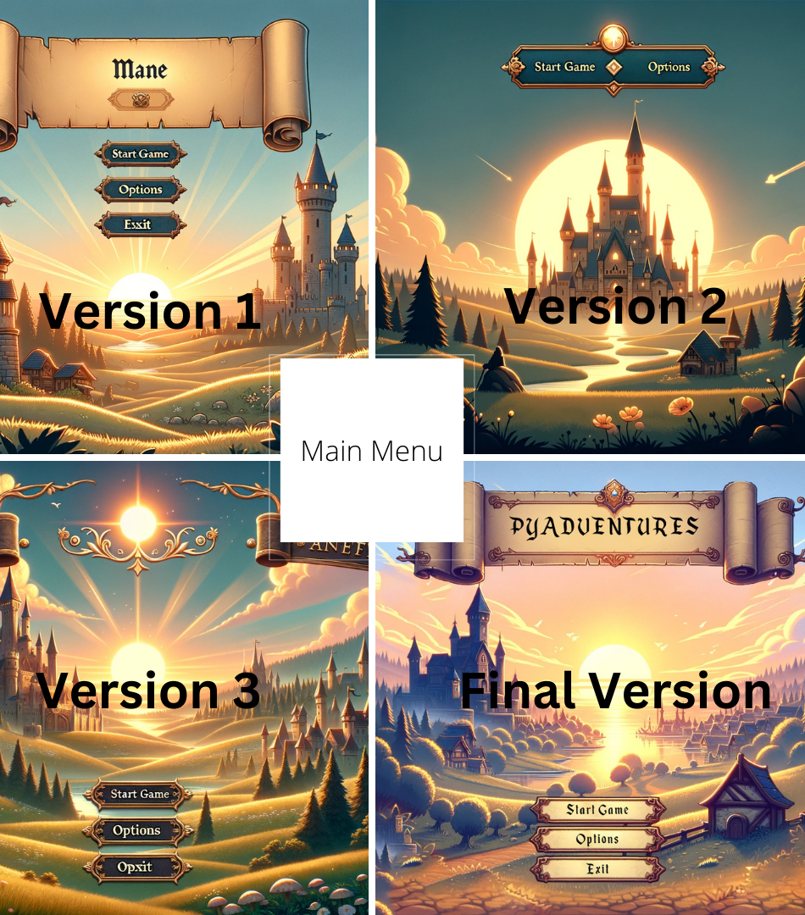
Gamification as a Solution
How PyAdventures Makes Learning Engaging:
Story-driven progression:
Players advance through a medieval-themed adventure.
Interactive quizzes & coding tasks:
Encourages hands-on learning.
Rewards & incentives:
Players earn coins for correct answers to buy hints.

Slide 5
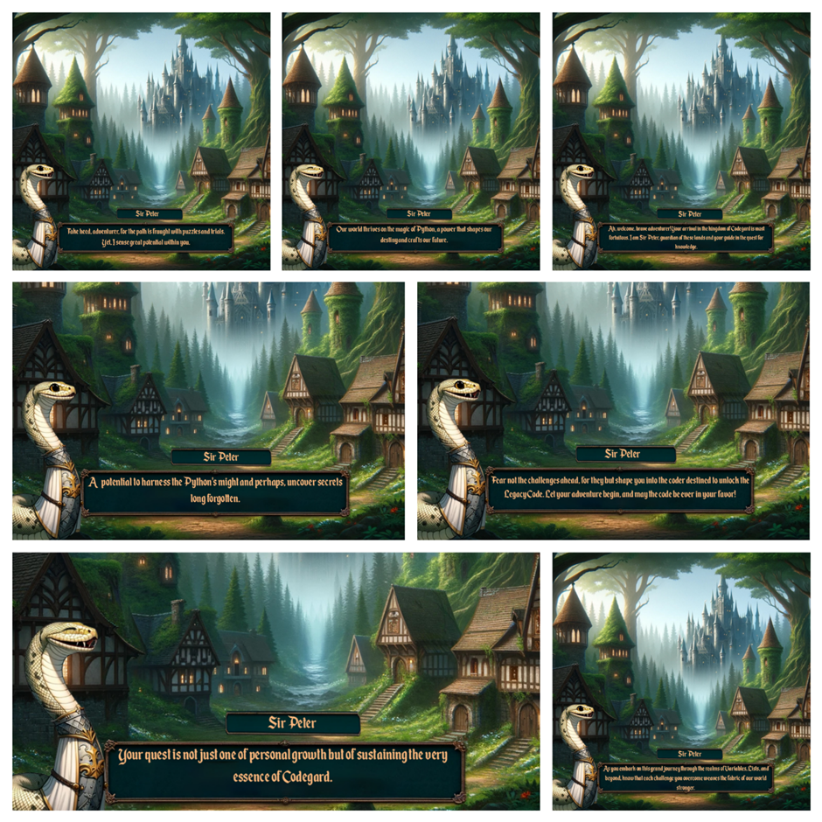
Game Design & Mechanics
Core Game Elements
Quizzes & coding challenges
Multiple-choice questions, drag-and-drop coding tasks.
Shop system
Players spend earned coins for hints or extra help.
Storytelling integration
Learning Python through immersive quests.

Slide 6
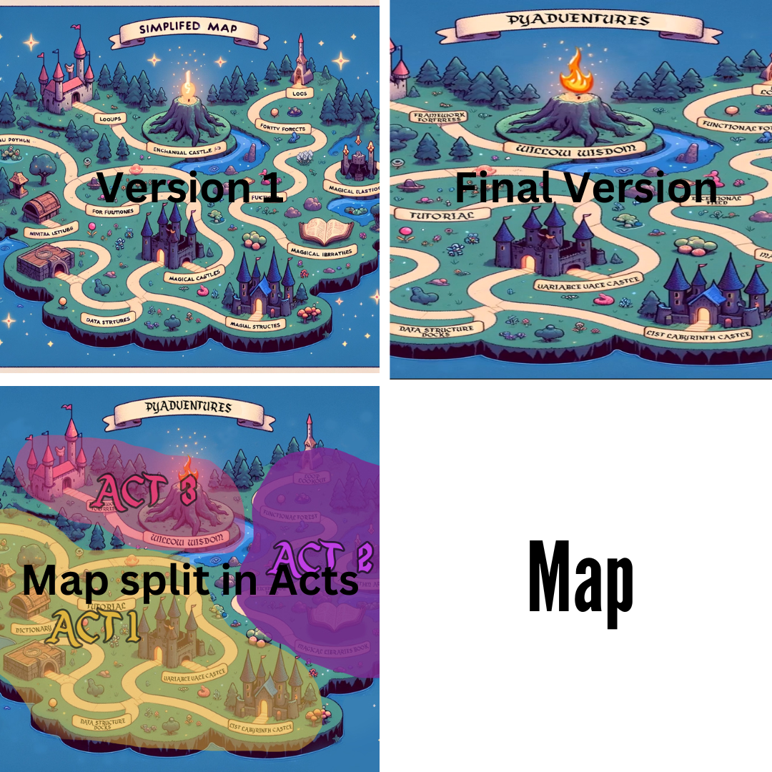
User Interface (UI) & User Experience (UX)
Key UI Features:
Intuitive menu design with simple navigation.
Top-down map layout for clear progress tracking
Interactive feedback system for real-time learning.
Accessibility Considerations
Clear fonts, tooltips, and hints to aid learning.

Slide 7
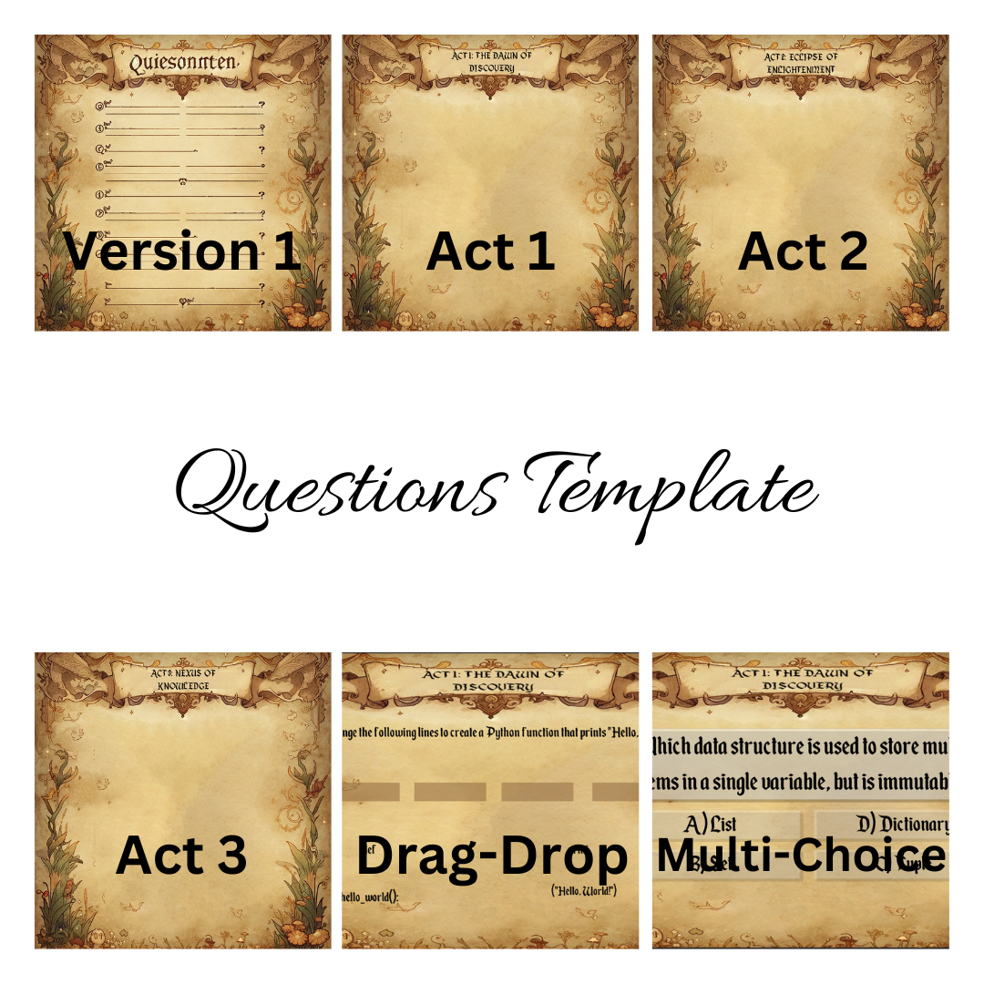
Example Tasks & Gameplay Elements
Coding Exercises:
Drag-and-drop Python syntax correction.
Multiple-choice logic puzzles.
Open-ended coding challenges with immediate feedback.
Game Features:
Visual hints and progress tracking.
Adaptive learning paths based on player performance.

Slide 8
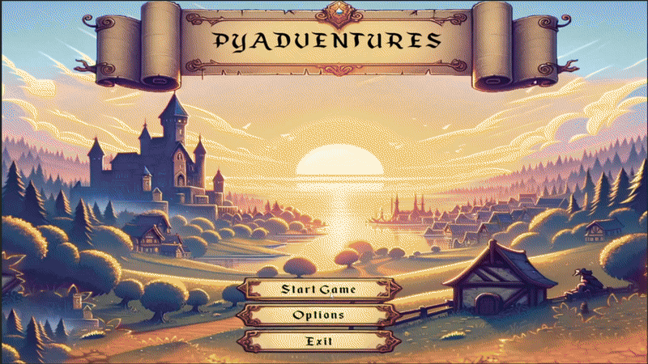
Technology & Development
Tools Used in Development:
Game Engine:
UnityAI-Generated Assets:
DALL-E for character and scene designs
Design & Animation:
Adobe Photoshop & After Effects
Development Methodology:
Agile development with iterative feedback.

Slide 9
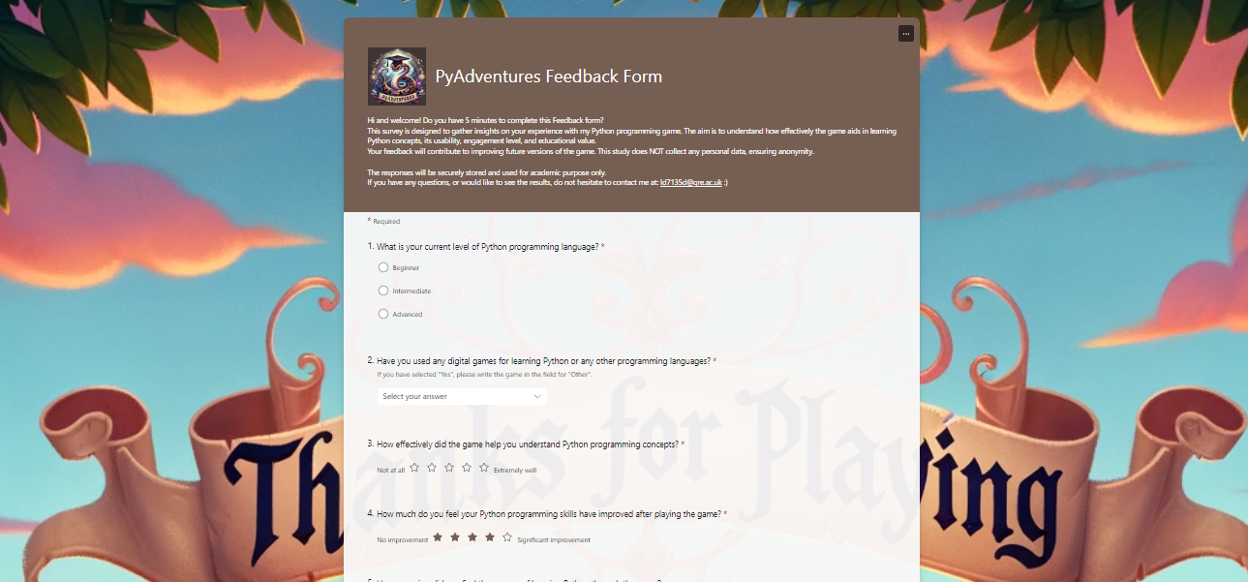
User Testing & Feedback
Testing Process:
Conducted usability tests with first-year programming students.
Gathered qualitative and quantitative feedback via surveys.
Improvements Based on Feedback:
Enhanced UI clarity and interactive tutorials.
Adjusted quiz difficulty based on user responses.
Added in-game hints for struggling players.

Slide 10
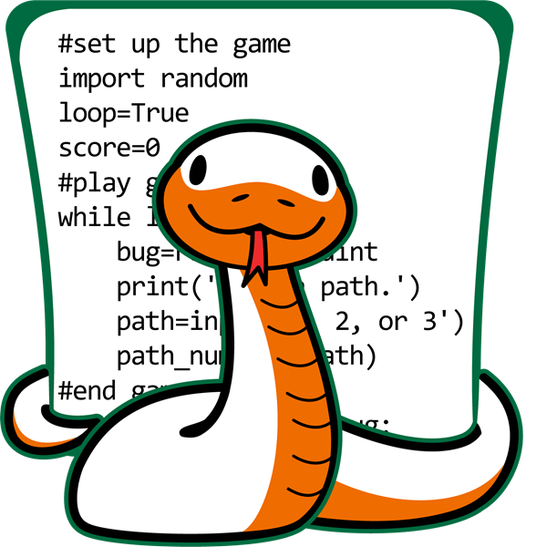
Educational Impact
Learning Outcomes:
Increased engagement and retention of Python concepts.
Encouraged problem-solving through interactive challenges.
Provided a structured, step-by-step approach to programming fundamentals.
User Testimonials:
"It made Python feel like an adventure rather than a lecture!"

Slide 11
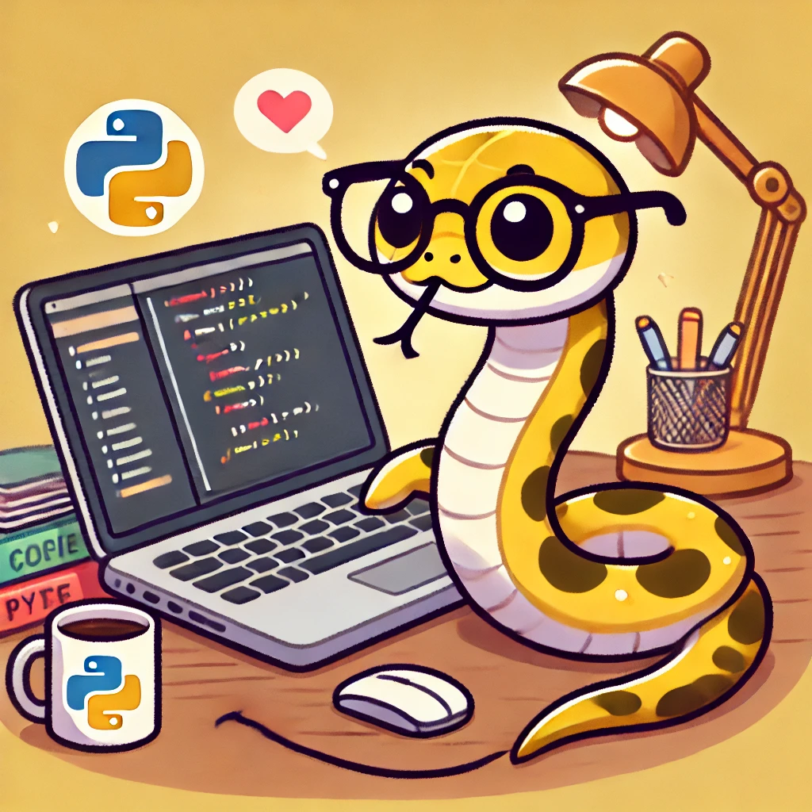
Challenges & Future Improvements
Current Limitations:
No multiplayer or collaborative features.
Limited personalization based on learning styles.
Shop system could be expanded with more rewards.
Planned Enhancements:
Adaptive difficulty levels – Tailor challenges based on player performance.
Expanded course content – Include more advanced Python topics.
Multiplayer challenges – Encouraging collaboration and competition.

Slide 12

Conclusion
PyAdventures revolutionizes Python education through gamification.
It merges storytelling, coding, and interactive challenges to create a fun and effective learning experience.
Future developments aim to refine the game further, ensuring a more engaging and personalized learning journey.

Slide 13
References
Deterding, S., Dixon, D., Khaled, R. and Nacke, L. (2011). From game design elements to gamefulness: Defining “gamification”.
Kapp, K. (2012). The gamification of learning and instruction: Game-based methods and strategies for training and education.
Kim, J. and Castelli, D.M. (2021). Effects of gamification on behavioral change in education
.Lahtinen, E., Ala-Mutka, K. and Järvinen, H. (2005). A study of the difficulties of novice programmers.
OpenGameArt (n.d.). Free 2D and 3D game assets. Available at: https://opengameart.org/ (Accessed: 13 Feb. 2025).
Ryan, R.M. and Deci, E.L. (2000). Self-determination theory and the facilitation of intrinsic motivation, social development, and well-being.
Smiderle, R., Rigo, S.J., Marques, L.B. et al. (2020). The impact of gamification on students’ learning, engagement, and behavior based on their personality traits.
Unity Technologies (n.d.). Unity documentation. Available at: https://docs.unity3d.com/ (Accessed: 13 Feb. 2025).

